Slide 1
Notes:
#0 – Blank Slide

Slide 2
Teamwork:
What’s Trust Got To Do With It?
Notes:
#1 – TITLE: TEAMWORK: What’s Trust Got To Do With It?

Slide 3
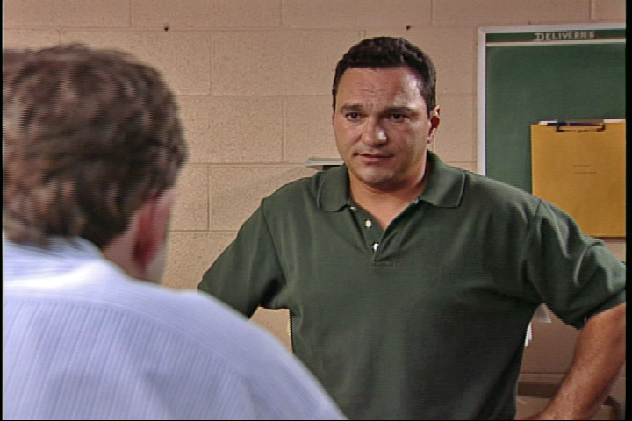
Trust is absolutely fundamental to getting anything done…. In organizations, it’s one
of the biggest issues that impedes progress.
- Fast Company Magazine
Notes:
#2 – QUOTE: “Trust is absolutely fundamental to getting anything done… In organizations, it’s one of the biggest issues that impedes progress.” – Fast Company Magazine

Slide 4
What makes you trust someone?
+ -
Traits: _______________ ______________
_______________ ______________
_______________ ______________
_______________ ______________
Effect on you
and/or your work: _______________ ______________
_______________ ______________
_______________ ______________
_______________ ______________
Notes:
#3 – CHART: What Makes You Trust Someone?

Slide 5
KEY TRAINING POINTS
Notes:
#4A – KEY TRAINING POINTS

Slide 6
KEY TRAINING POINTS
l Trust is the foundation of teamwork.
Notes:
#4B – KEY POINTS: Trust is the foundation of teamwork.

Slide 7
KEY TRAINING POINTS
l Trust is the foundation of teamwork.
l The three most important trust-building behaviors are:
Notes:
#4C – KEY POINTS: The three most important trust-building behaviors are:

Slide 8
KEY TRAINING POINTS
l Trust is the foundation of teamwork.
l The three most important trust-building behaviors are:
1. Openness
Notes:
#4D – KEY POINTS: 1. Openness

Slide 9
KEY TRAINING POINTS
l Trust is the foundation of teamwork.
l The three most important trust-building behaviors are:
1. Openness
- Share ideas, questions and concerns
Notes:
#4E – KEY POINTS: Share ideas, questions and concerns

Slide 10
KEY TRAINING POINTS
l Trust is the foundation of teamwork.
l The three most important trust-building behaviors are:
1. Openness
- Share ideas, questions and concerns
- Do not hold back information
Notes:
#4F – KEY POINTS: Do not hold back information

Slide 11
KEY TRAINING POINTS
l Trust is the foundation of teamwork.
l The three most important trust-building behaviors are:
1. Openness
- Share ideas, questions and concerns
- Do not hold back information
2. Credibility
Notes:
#4G – KEY POINTS: 2. Credibility

Slide 12
KEY TRAINING POINTS
l Trust is the foundation of teamwork.
l The three most important trust-building behaviors are:
1. Openness
- Share ideas, questions and concerns
- Do not hold back information
2. Credibility
- Demonstrate your competence
Notes:
#4H – KEY POINTS: Demonstrate you competence

Slide 13
KEY TRAINING POINTS
l Trust is the foundation of teamwork.
l The three most important trust-building behaviors are:
1. Openness
- Share ideas, questions and concerns
- Do not hold back information
2. Credibility
- Demonstrate your competence
- Do what you promise to do
Notes:
#4I – KEY POINTS: Do what you promise to do

Slide 14
KEY TRAINING POINTS
l Trust is the foundation of teamwork.
l The three most important trust-building behaviors are:
1. Openness
- Share ideas, questions and concerns
- Do not hold back information
2. Credibility
- Demonstrate your competence
- Do what you promise to do
- If you can’t deliver, own up to it and work out a solution
Notes:
#4J – KEY POINTS: In you can’t deliver, own up to it and work out a solution

Slide 15
KEY TRAINING POINTS
l Trust is the foundation of teamwork.
l The three most important trust-building behaviors are:
1. Openness
- Share ideas, questions and concerns
- Do not hold back information
2. Credibility
- Demonstrate your competence
- Do what you promise to do
- If you can’t deliver, own up to it and work out a solution
3. Respect
Notes:
#4K – KEY POINTS: Respect

Slide 16
KEY TRAINING POINTS
l Trust is the foundation of teamwork.
l The three most important trust-building behaviors are:
1. Openness
- Share ideas, questions and concerns
- Do not hold back information
2. Credibility
- Demonstrate your competence
- Do what you promise to do
- If you can’t deliver, own up to it and work out a solution
3. Respect
- Acknowledge the skill and expertise of your team
Notes:
#4L – KEY POINTS: Acknowledge the skill and expertise of your team

Slide 17
KEY TRAINING POINTS
l Trust is the foundation of teamwork.
l The three most important trust-building behaviors are:
1. Openness
- Share ideas, questions and concerns
- Do not hold back information
2. Credibility
- Demonstrate your competence
- Do what you promise to do
- If you can’t deliver, own up to it and work out a solution
3. Respect
- Acknowledge the skill and expertise of your team
- Respond to legitimate concerns of your team
Notes:
#4M – KEY POINTS: Respond to legitimate concerns of your team

Slide 18
KEY TRAINING POINTS
l Trust is the foundation of teamwork.
l The three most important trust-building behaviors are:
1. Openness
- Share ideas, questions and concerns
- Do not hold back information
2. Credibility
- Demonstrate your competence
- Do what you promise to do
- If you can’t deliver, own up to it and work out a solution
3. Respect
- Acknowledge the skill and expertise of your team
- Respond to legitimate concerns of your team
l Trust-building behavior must be genuine and ongoing.
Notes:
#4N – KEY POINTS: Trust-building behavior must be genuine and ongoing.

Slide 19
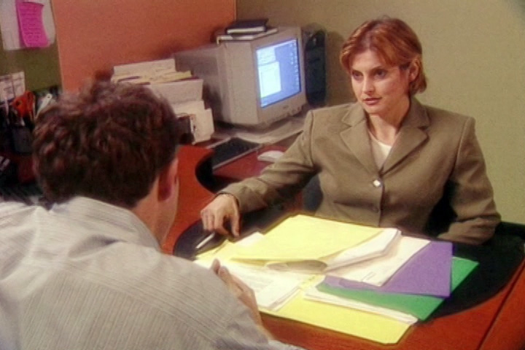
Trust allows people in organizations
to work together more effectively.
Notes:
#5A – QUOTE: “Trust allows people in organizations to work together more effectively.”

Slide 20
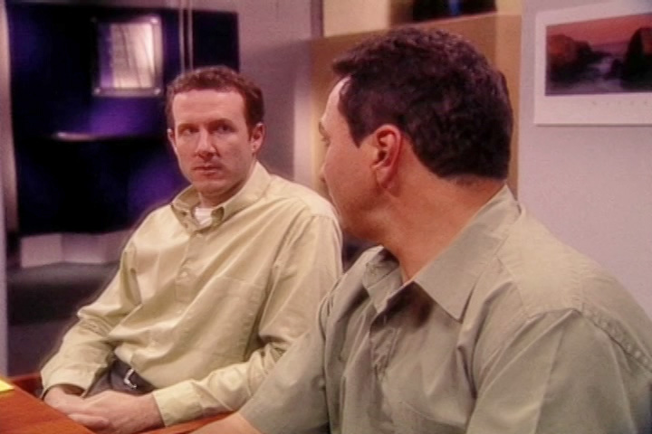
Trust allows people in organizations
to work together more effectively.
Your ability to trust others grows with your own ability to trust yourself…
others’ willingness to put their trust in
you is influenced by their perception
that you see yourself as trustworthy.
- Harvard Management Update
Notes:
#5B – QUOTE: “Your ability to trust others grows with your own ability to trust yourself…others’ willingness to put their trust in you is influenced by their perception that you see yourself as trustworthy. - Harvard Management Update

Slide 21
Trust is like money in the bank… It takes a long time to build up
some solid savings, and it takes
next to nothing to blow it all.
- “TEAMWORK: What’s Trust
Got To Do With It” video
Notes:
#6 – QUOTE: “Trust is like money in the bank… It takes a long time to build up some solid savings, and it takes next to nothing to blow it all.” - “TEAMWORK: What’s Trust Got To Do With It?” video

Slide 22
Teamwork:
What’s Trust Got To Do With It?
Notes:
#7 – TITLE: TEAMWORK: What’s Trust Got To Do With It?

Slide 23
Notes:
#8 – Blank Slide

